Slide 1

Project 1: Data Scientist’s Dilemma: Finding the Optimal State for Career and Quality of Life
Renato Barbosa, Mia Serrano-Salow, Jalaine Pruitt, Nelson Velasco
UM Data Analytics Boot Camp
November 6th, 2023

Slide 2
Our Motivation
The job market for the tech industry, more specifically for data scientists, has expanded drastically in the last decade. Due to such high demand in the field, job opportunities have become more competitive, making it more difficult to secure positions and stand out from the crowd. As a result, data scientists are increasingly considering not only their potential earnings but also the overall lifestyle and quality of life in the state where they choose to settle. In this presentation, we'll explore the best states for data scientists based on both average salary and quality of life factors, helping you make an informed decision about where to build your career and call home.

Slide 3
Key Research Questions
What are the top 5 best and top 5 worst states in the U.S. for a data scientist to live in terms of median annual salary?
What are the top 5 most expensive states to live in and the top 5 least expensive states to live in?
How does the average data scientist salary after tax compare to that of other professions in each state? Which are the most positive and negative states?
What is the best state to live in as a data scientist based on all this information?
What recommendations can be made to individuals working in the data science field to navigate the balance between job opportunities and housing affordability in urban areas?

Slide 4

Our Core Hypothesis
We hypothesize that the average earnings for data scientists is going to be more than the average earning of other professions.

Slide 5

Data Exploration and Clean-Up

Slide 6
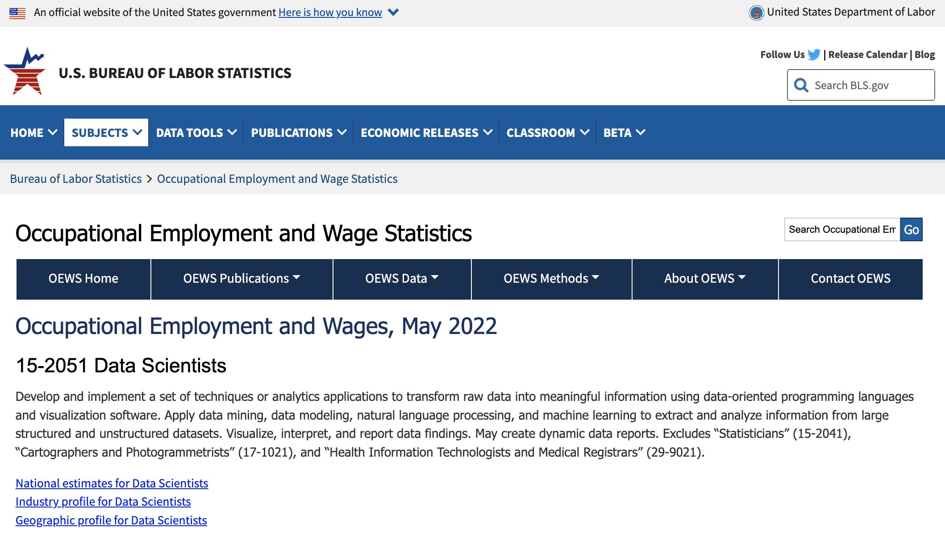
Where is our data scientist national average wages data from?
https://www.bls.gov/oes/current/oes152051.htm

Slide 7
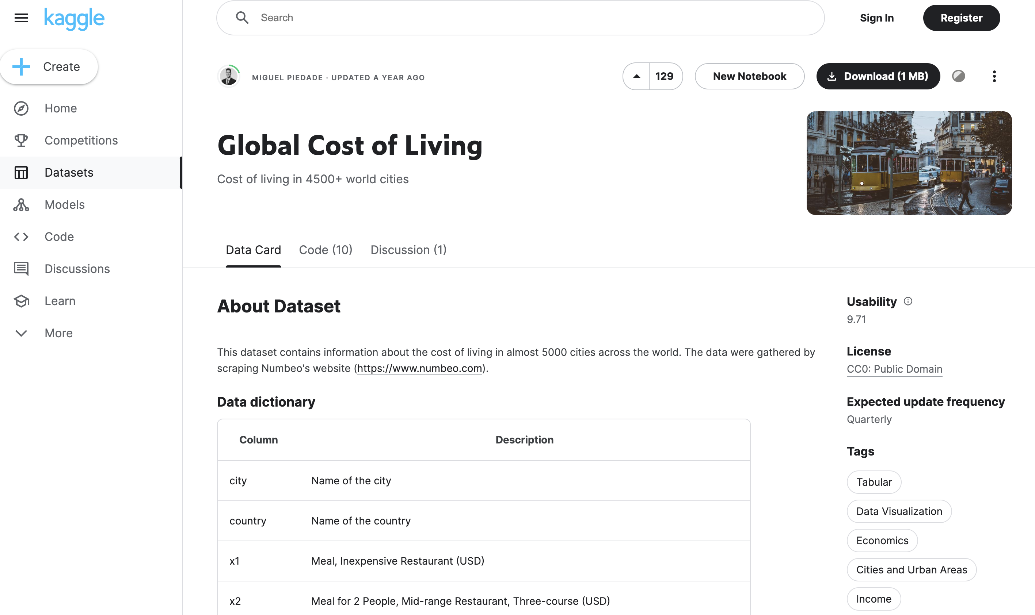
Where is our cost of living data from?
https://www.kaggle.com/datasets/mvieira101/global-cost-of-living/data

Slide 8
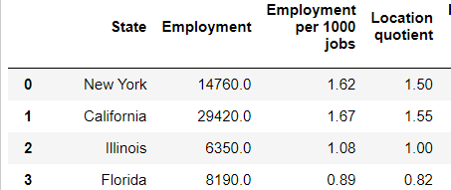
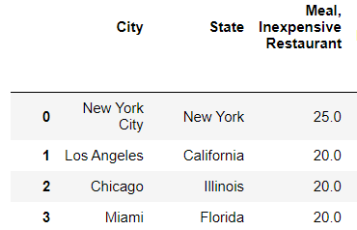
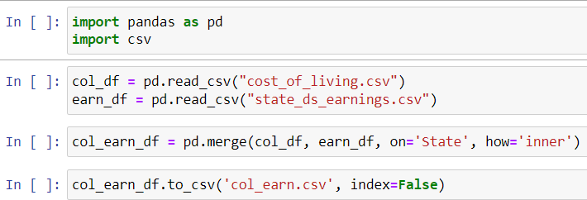
How to combine both datasets
Our Data Scientists Earnings dataset was at the state level, while our Cost of Living dataset was at the city level.
Data Scientists Earnings
Cost of Living
Our common key between both datasets was the [State]

Slide 9
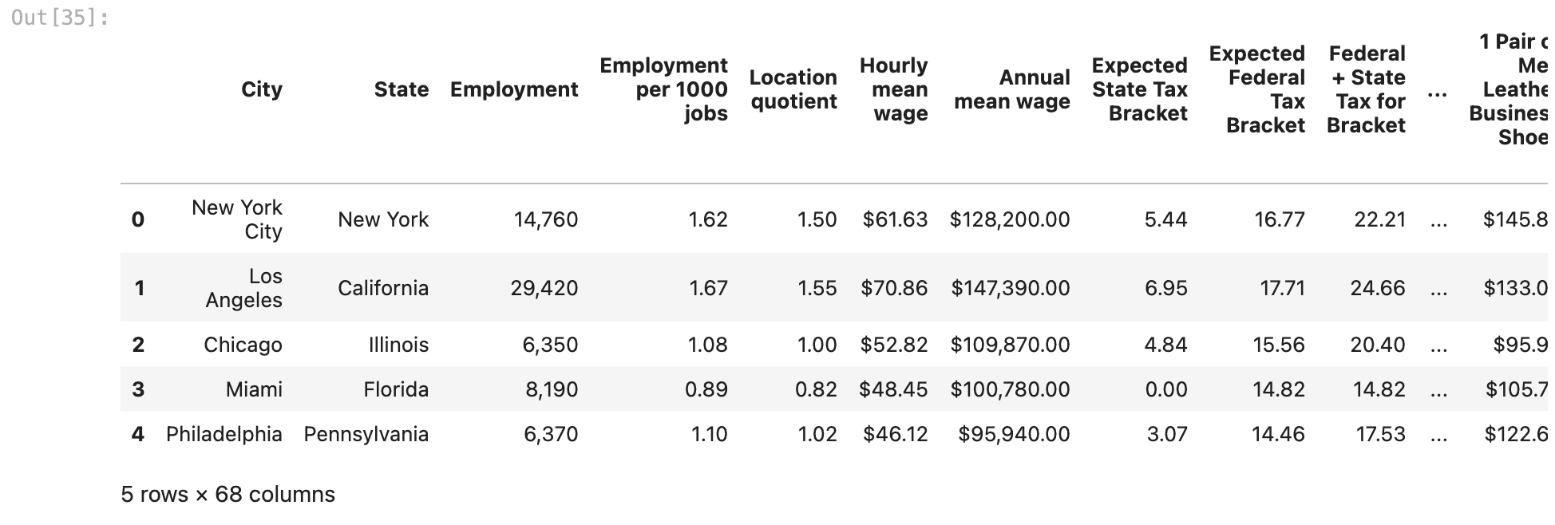
Snippet of data scientist wage data before cleaning

Slide 10
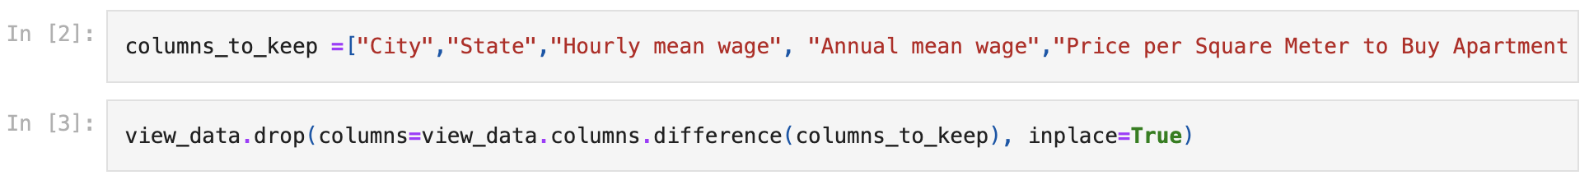
What did we do to clean up?
Filtered out unnecessary columns that did not pertain to our research

Slide 11
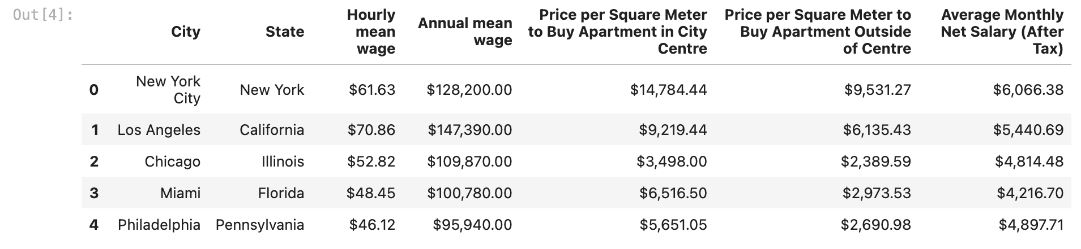
Snippet of data after cleaning

Slide 12
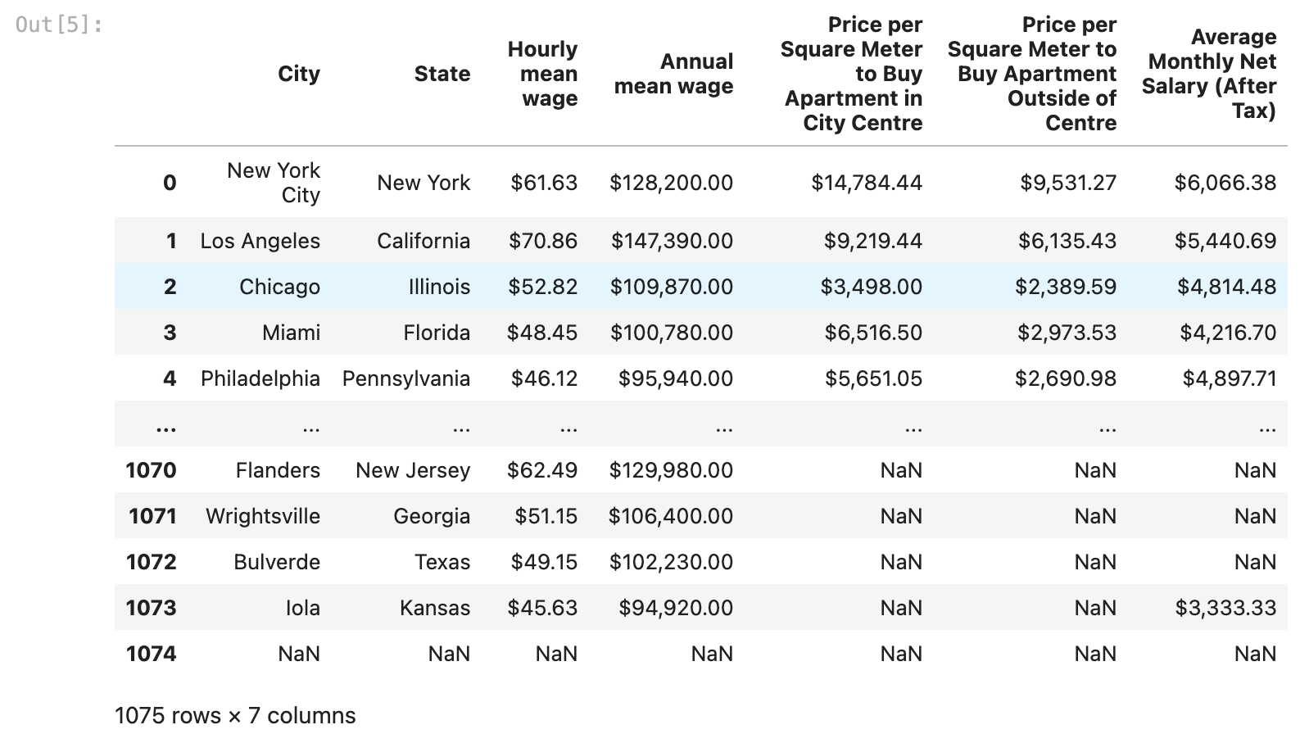
Snippet of cost of living data before cleaning

Slide 13
What did we do to clean up?
Filtered out null values
Most of the data in this data set already contained data that we needed, so the clean-up process was shorter.

Slide 14
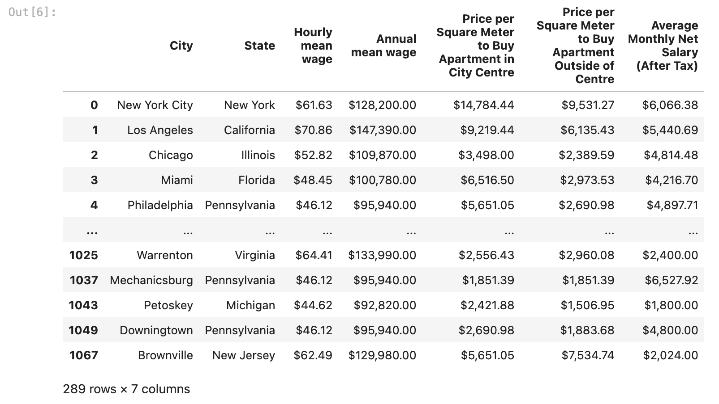
Snippet of data after cleaning

Slide 15

Data Analysis

Slide 16
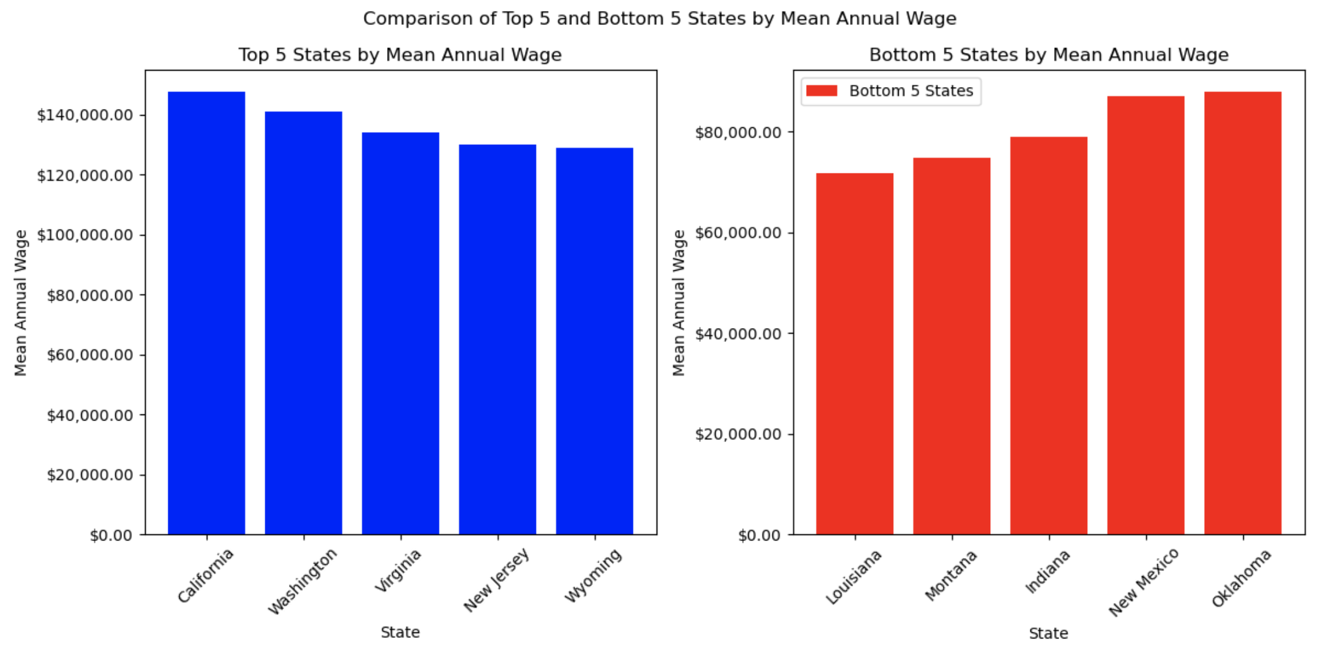
What are the top 5 best and worst states to live in based on mean wage?

Slide 17
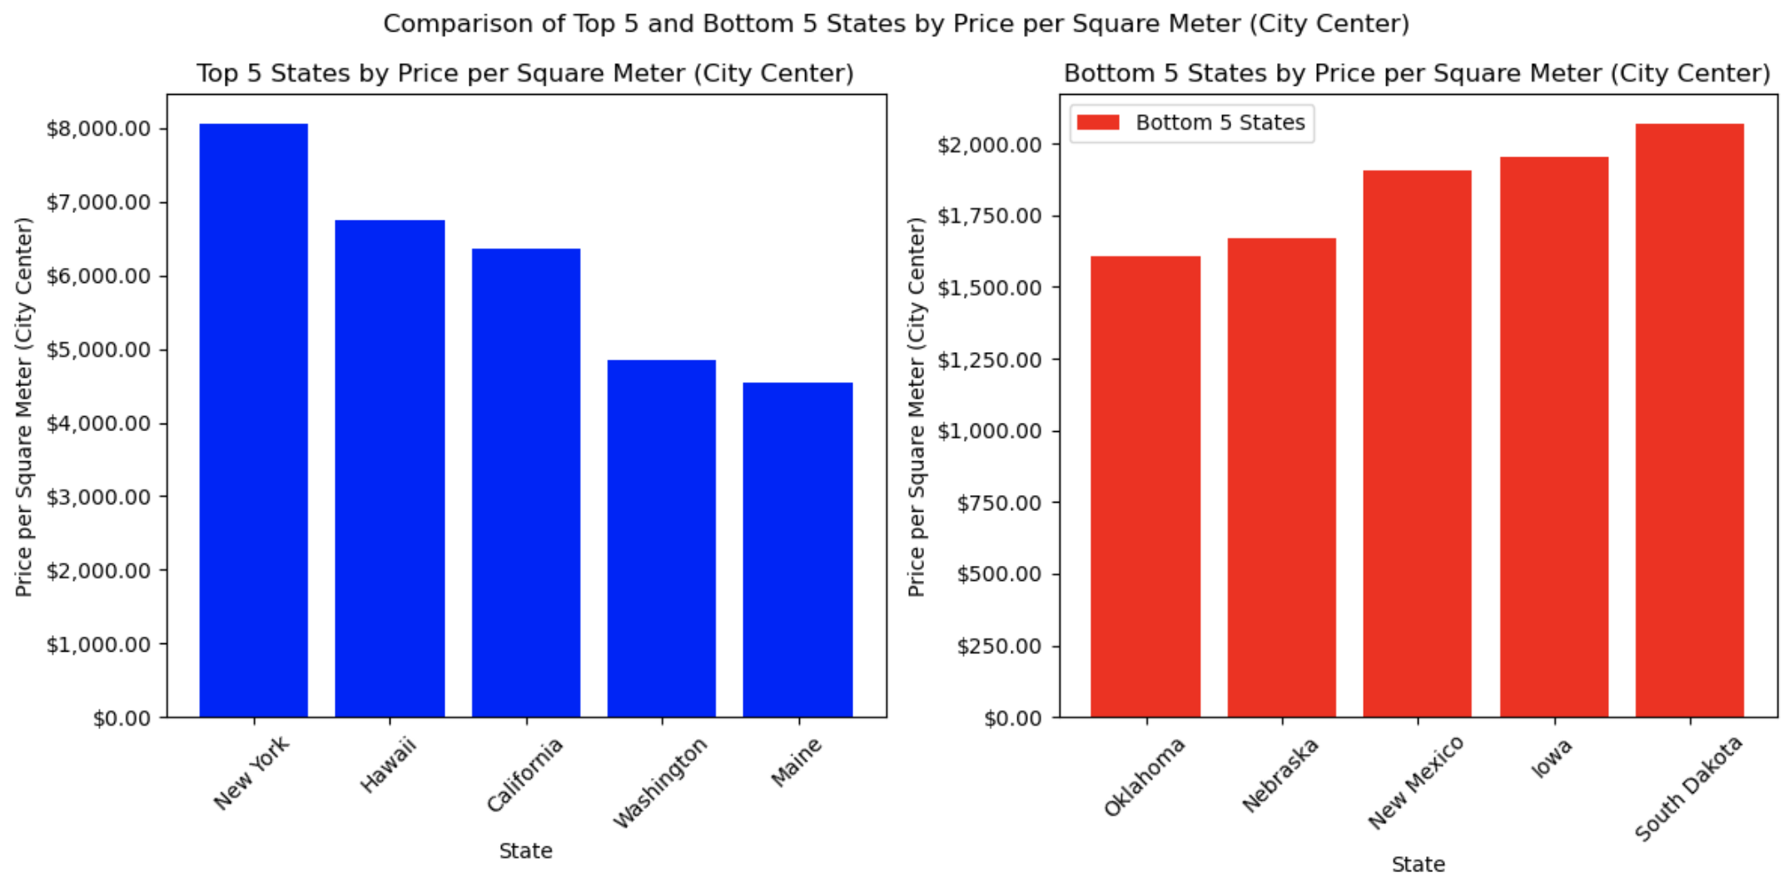
What are the top 5 most expensive and least expensive states (urban area)?

Slide 18
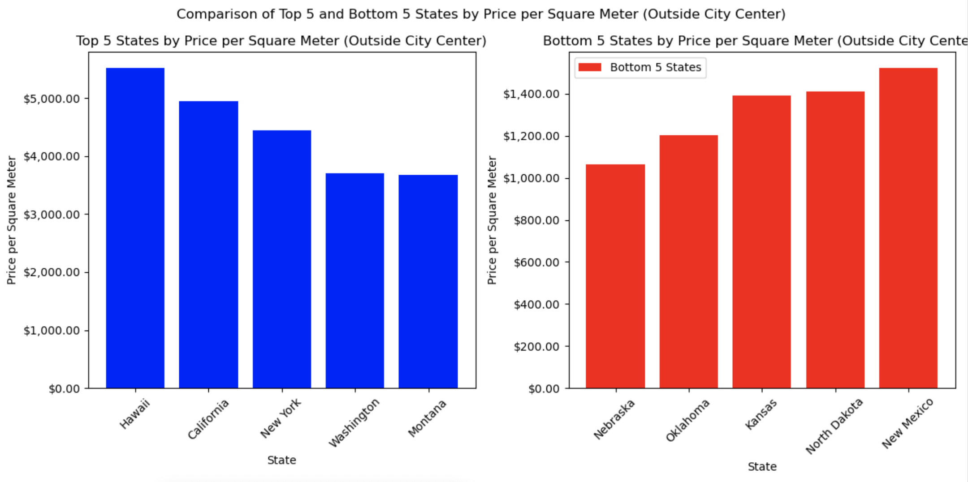
What are the top 5 most expensive and least expensive states (suburban area)?

Slide 19
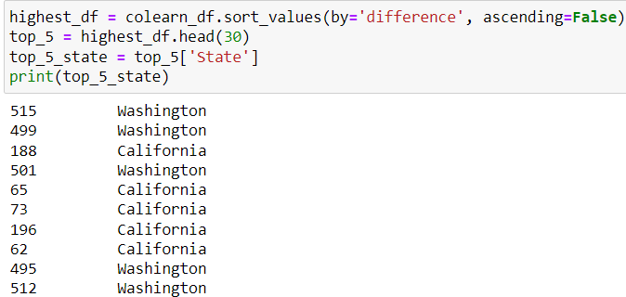
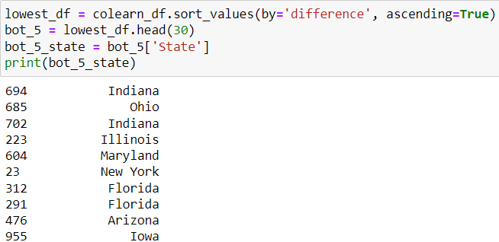
Data Scientist Salary vs. Other Professions Salary
Individual values at the city level
Top 5 Highest Difference
Bottom 5 Lowest Difference

Slide 20
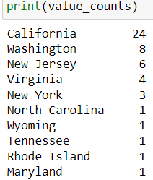
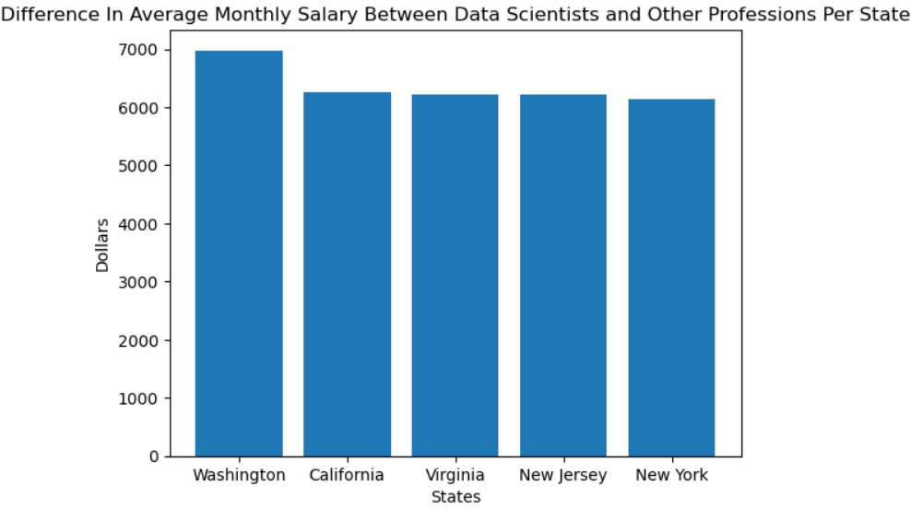
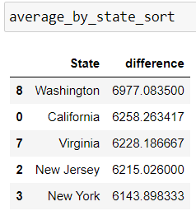
Top 5 State Count and Average Salary Difference

Slide 21
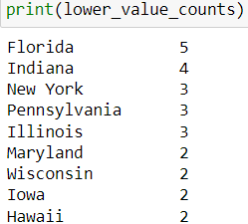
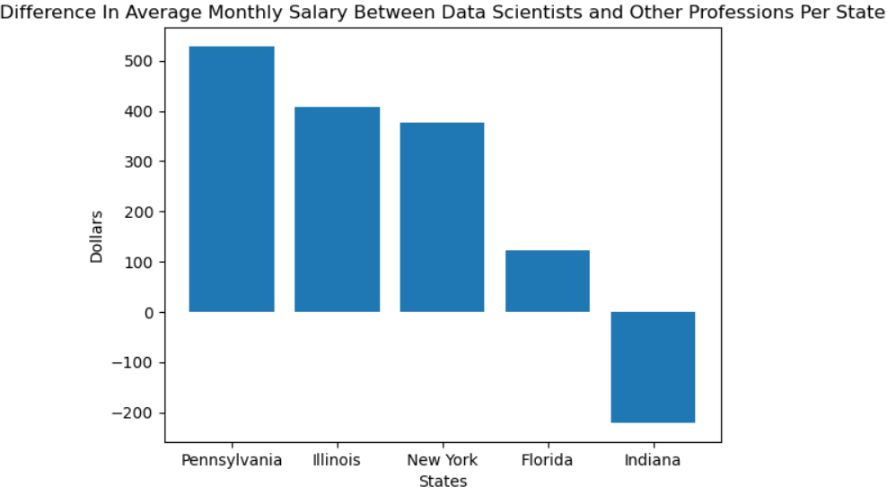
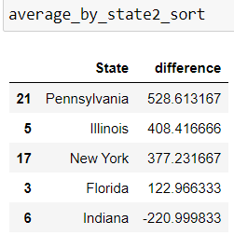
Bottom 5 State Count and Average Salary Difference

Slide 22
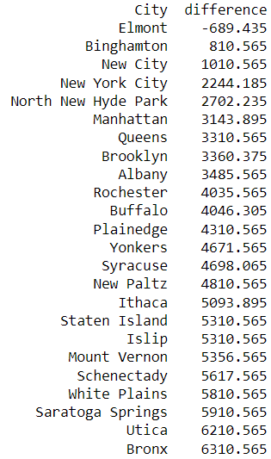


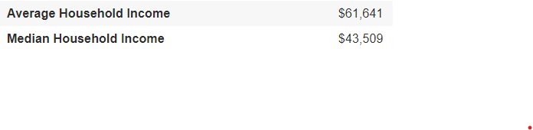
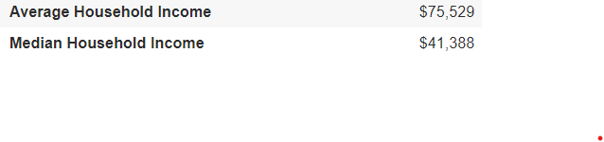

What’s Happening in New York?
Elmont
New City
Utica
Bronx
Source:

Slide 23
Data Scientists seem to make a comfortable salary in most parts of the country
with the national average salary for Data Scientists being $7550 per month
Consider the following cities when job hunting based on your field preference:
Data Scientists:
Pullman, Washington
Marysville, Washington
Yakima, Washington
Monterey California
Modesto, California
San Bernardino, California
Other Fields:
Carmel, Indiana
Jeffersonville, Indiana
New Port Richey, Florida
Jupiter, Florida
Elmont, New York
Des Plaines, Illinois

Slide 24
Conclusion: Best State to Live In
We have concluded that there are two states that are the best to live in if you are a data scientist. These states are Washington and California. We have concluded this because although they are both two of the most expensive states to live in inside and outside city centers, their high salaries for Data Scientists compared to other fields outweighs the cost of living.

Slide 25
What recommendations can be made to individuals working in the data science field to navigate the balance between job opportunities and housing affordability in urban areas?
A few recommendations to individuals working in the data science field to navigate the balance between job opportunities and housing affordability in urban areas would be to research the city, consider remote jobs, budgeting, and salary negotiation.
You should research the city before considering accepting a job in the data science industry. You want to research the cost of living and job demand. You may want to consider remote job opportunities to save money. You can cut costs on transportation and groceries. Gas prices are steadily increasing. By working remotely, you can eat at home versus eating out. Working remote can also eliminate you driving a long distance to work. Driving an hour or longer to and from work depending on traffic could cause stress. Especially on days when you are mentally exhausted.
Another recommendation is budgeting. Make sure you prepare a monthly budget to ensure you are not living above your means. Minimize expenses as much as possible. Have a strict budget and stick to it. Lastly, negotiate your salary. You never know until you ask. Persuade the company that you add value and have the qualities and expertise to perform the job.

Slide 26
Was out hypothesis right

Slide 27

Limitations/Unanticipated Insights

Slide 28
While researching the topic we chose and attempting to collect data, we were unable to find an accessible API for our data set from the Bureau of Labor Statistics. Because of this, we made the collective decision to not use an API for our project.
Our analysis based on state data could be inaccurate due to some cities’ high standard deviation of data.
Limitation to our data: For a much more accurate breakdown at the city level, we could have used specific earnings for data scientists for each city in the country, however such data for the whole country was not ready available or accessible.
More time = more research
A larger window of time for this project could have allowed for more in-depth research, contributing to the accuracy of data.

Slide 29

Questions?

